Slide 1
Components, States & State Management
https://github.com/tnt-summer-academy/Curriculum-2022/blob/main/Week%205/components%20states.md
Created for Microsoft / TNTs

Slide 2
Learning objectives
TNTs will review class and function components
TNTs will review states and state hooks
TNTs will learn about state management in a React app
TNTs will understand why we need a more general solution to manage states
TNTs will learn what Recoil is
TNTs will experiment with Recoil
TNTs will learn about other solutions and how they compare to Recoil

Slide 3
Organisation of the session

Slide 4
Organisation of the session
Slides
1 demo of props and state
https://github.com/tnt-summer-academy/Samples/tree/main/Week_5/house-app
2 demos with Recoil
Character counter
Todolist
https://github.com/tnt-summer-academy/Samples/tree/main/Stretch/recoil-todo-javascript
QA

Slide 5
Resources
React components
React State
Recoil
Recoil for beginners
Redux basic tutorial
Videos on React with Redux - Parts 1 to 11
React Context

Slide 6
PART 0
SAVING DATA IN APPS

Slide 7
Data
Hard coded
JSON file
Database – SQL or NoSQL
for an app or several apps, persistent data
State
for a component, changing data
Redux / Recoil / React Context
for an app, changing data
Etc.

Slide 8
PART 1
REVIEW OF COMPONENTS AND STATES

Slide 9
What are components?
React components let you break up the user interface into separate pieces that can then be reused and handled independently
A React component takes an optional input and returns a React element which is rendered on the screen
A React component can be either “stateful” or "stateless“
“Stateful” components are of the class type, while “stateless” components are of the function type
React components may have props (properties) and state

Slide 10
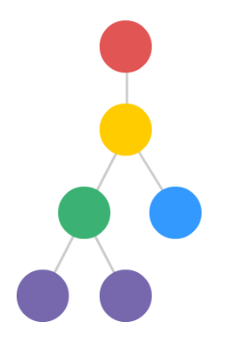
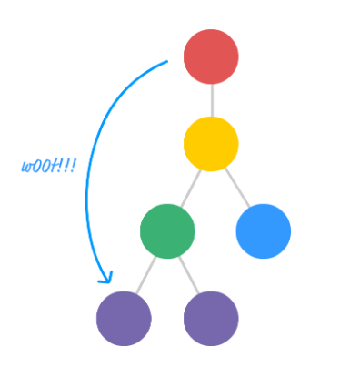
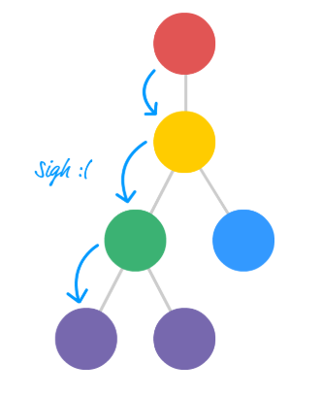
Props
<Room name = “Kitchen”/>
name is a props
https://www.kirupa.com
Optional
Read-only

Slide 11
How did you manage the states of your components so far?

Slide 12
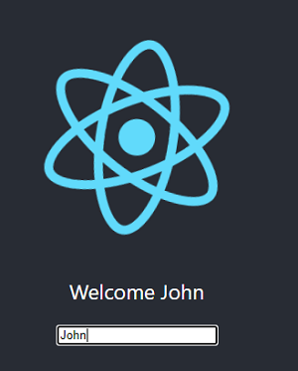
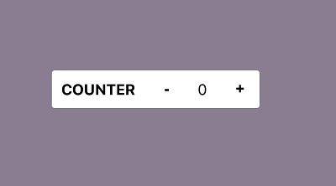
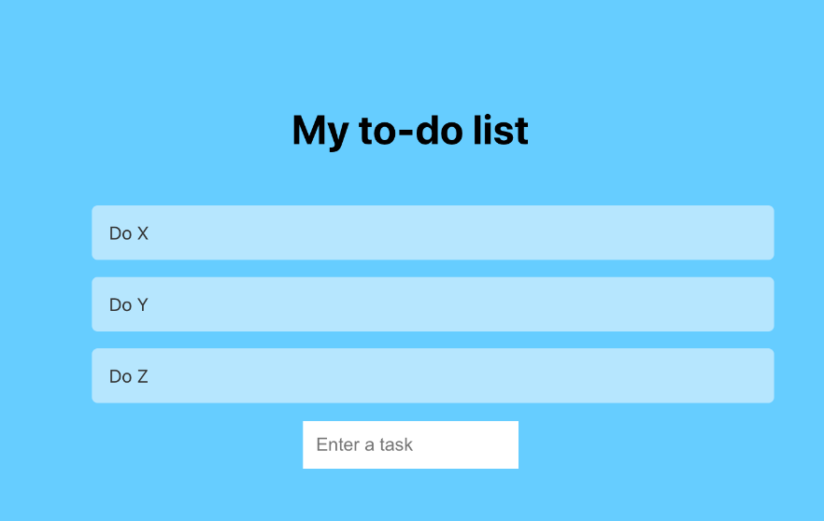
State
Optional
Changes over time
The state is specific to a component.
It is an object that holds information that can change over the lifetime of a component.
A component is rendered each time the state changes.
Examples
The name is the state
The value of the counter is the state
The todo list is the tate

Slide 13
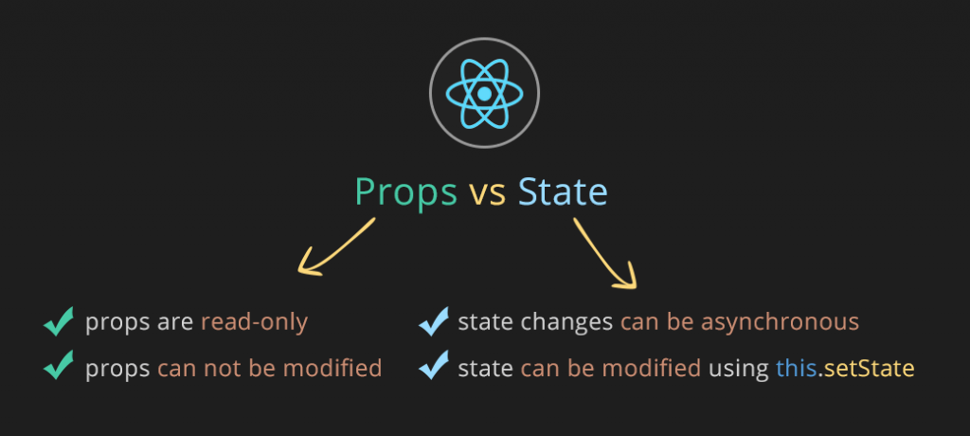
https://i.stack.imgur.com/wqvF2.png

Slide 14
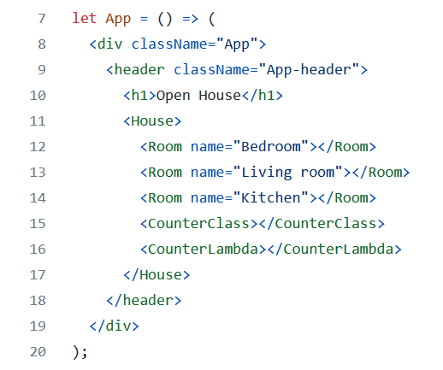

What’s children?
<House>
<Room name=”bedroom”/>
<Room name=”kitchen”/>
</House>
// Room is a child of House
You use (this.)props.children on components that represent ‘generic boxes’ and that ‘don’t know their children ahead of time’
(this.)props.children is used to display whatever you include between the opening and closing tags when invoking a component
Notes:
https://github.com/microsoft/TypeScript/issues/6471

Slide 15
Classes

Slide 16
Classes
Render (required): This method returns the JSX element to be displayed by the class. It runs whenever the component's view updates.
Properties (optional): They are arguments passed into the component from its parent components. They cannot be changed by the component.
State (optional): They only exist within the components. Changing them causes the component to update.
Children (optional): Components nested inside the parent's JSX tags
Besides render(), class can include a constructor, lifecycle method calls and other additional methods.
Notes:
https://reactjs.org/docs/glossary.htm

Slide 17
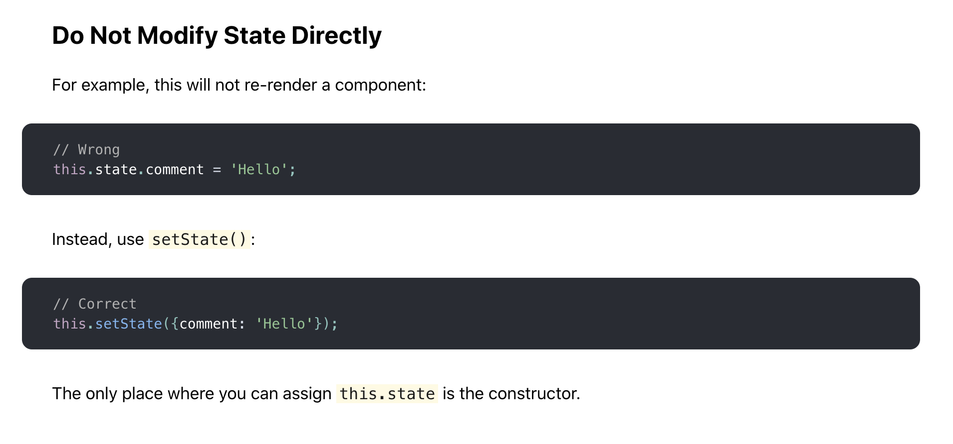
Using state correctly – Use setState
Read infos here: https://reactjs.org/docs/state-and-lifecycle.html#state-updates-may-be-asynchronous

Slide 18
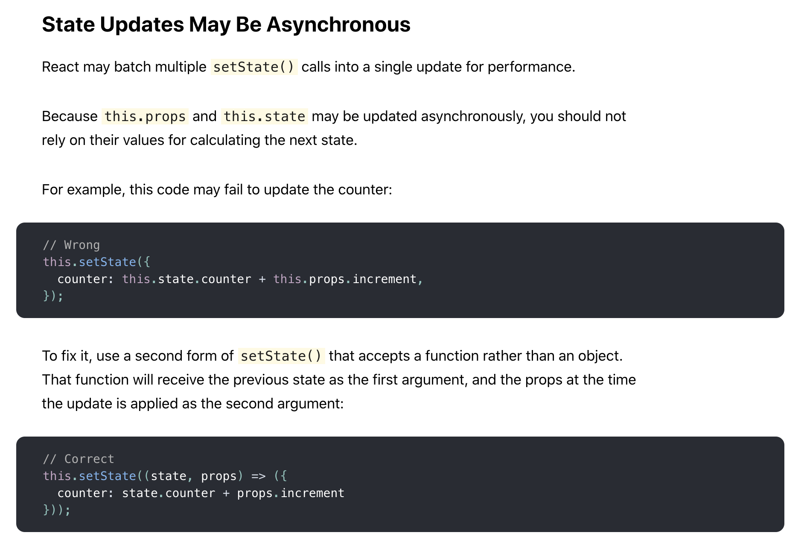
Using state correctly – Do not use this.props and this.state inside setState without lambda
Asynchronous changes and access

Slide 19
From a question: How to update the state when the state is composed of several variable and only one changes?
this.setState(
{
...this.state, // <------ spread operator
password : newpassword}
)

Slide 20
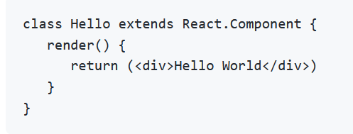

Slide 21
Functions

Slide 22
Functions
Originally simple, stateless components, they are expected to return the JSX element to be displayed.
Properties (optional): These arguments are passed in from the component's parent similarly to passing parameters to a function. They cannot be changed in the component.
UseState: A hook function that returns a state variable, giving function components a way to manipulate a state the way class components do
Notes:
https://reactjs.org/docs/glossary.htm

Slide 23
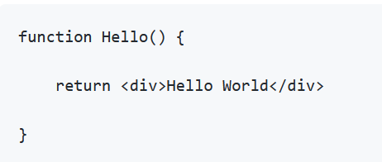

Without lambda
With lambda

Slide 24
Functions and hooks

Slide 25
What is a hook?
A Hook is a special function that lets you “hook into” React features.
For example, useState is a Hook that lets you add React state to function components.
State hook are hooks for adding a state to a function component.
When would I use useState?
If you write a function component and realize you need to add some state to it, previously you had to convert it to a class.
Now you can use a hook inside the existing function component. We’re going to do that right now!
https://reactjs.org/docs/hooks-state.html

Slide 26
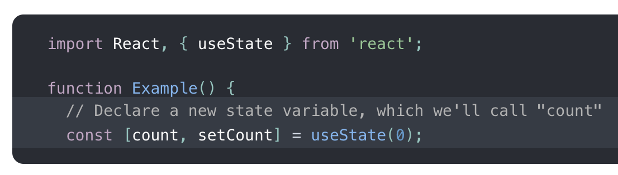
Example of state hook
useState hooks directly inside a component
count is the state variable
The argument of useState is the initial state
useState returns a pair of values - the current state and a function that updates it, here setCount

Slide 27
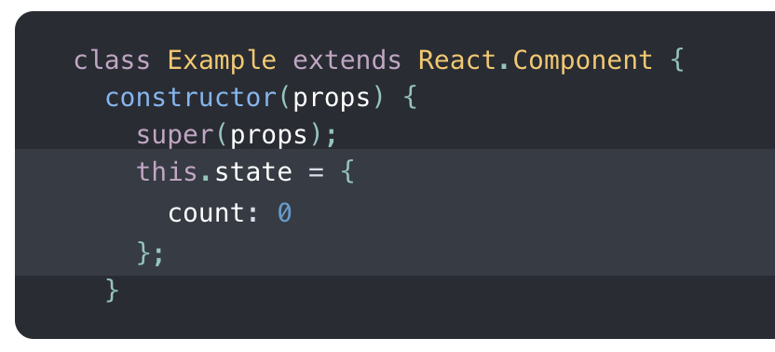
Comparison of class state and function state hook
Function with state hook
Class with state
useState hooks directly inside a component
count is the state variable
The argument of useState is the initial state
useState returns a pair of values - the current state and a function that updates it, here setCount
State
setState function to update the stace

Slide 28
Rules of Hooks
https://reactjs.org/docs/hooks-rules.html
Call Hooks from React function components only (not from JS functions)
Don’t call Hooks inside loops, conditions, or nested functions.
Call Hooks in the same order each time a component renders.

Slide 29
Code

Slide 30
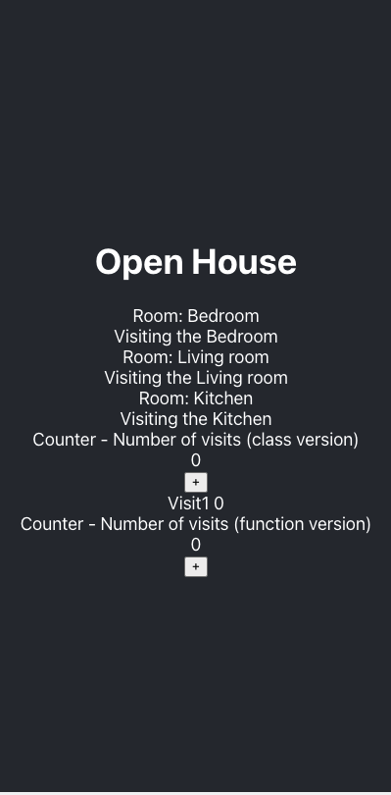
house-app https://github.com/tnt-summer-academy/Samples/tree/main/Week_5/house-app

Slide 31
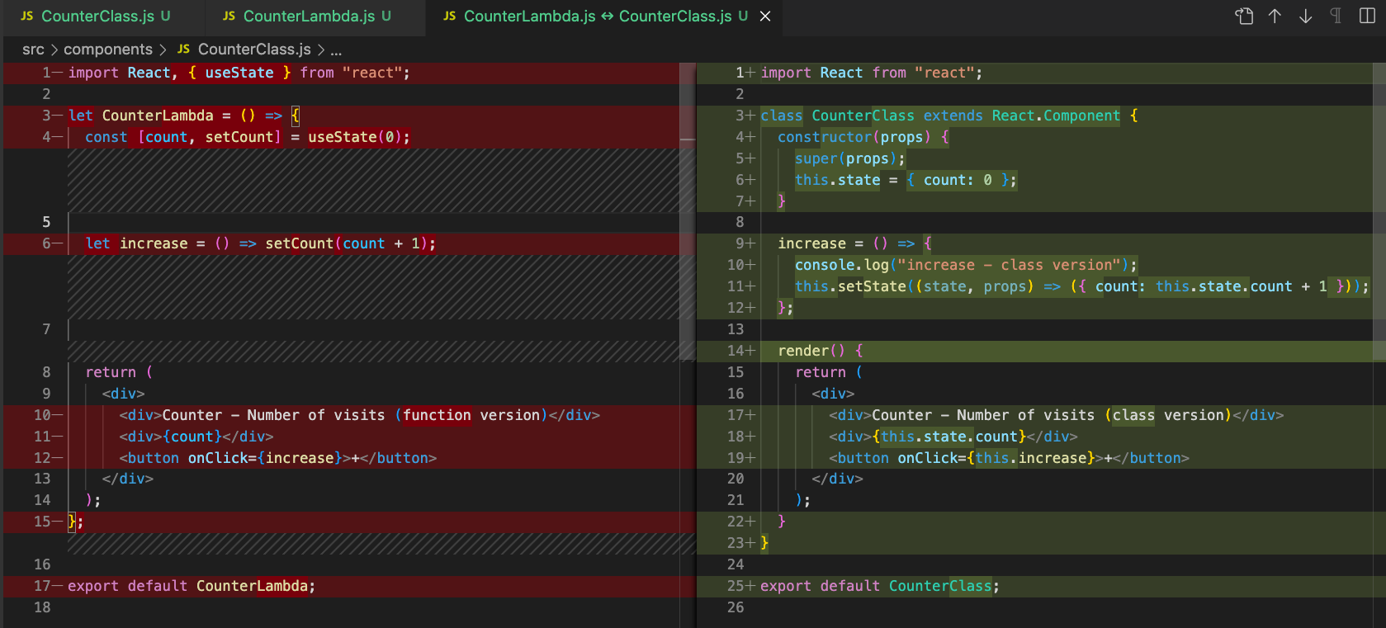

Slide 32
PART 2 WHY DO WE NEED RECOIL OR ANOTHER SOLUTION?

Slide 33
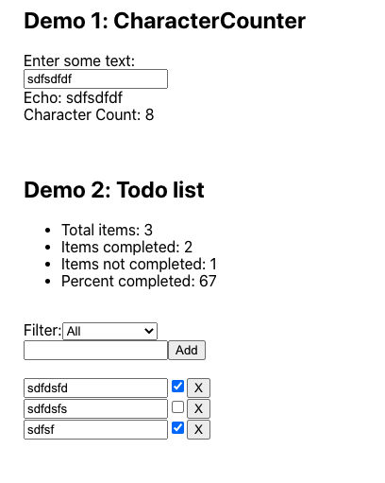
Let’s look at this example

Slide 34
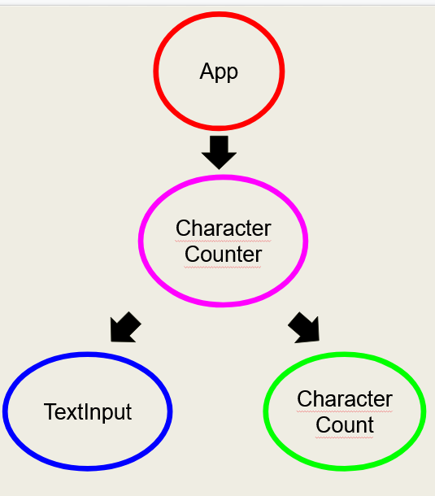
<App>
<TextInput>
<CharacterCount>
<CharacterCounter>

Slide 35
App
CharacterCounter
TextInput
CharacterCount

Slide 36
<App>
State of TextInput
<TextInput>
Depends on the state of <TextInput>>
<CharacterCount>
<CharacterCounter>

Slide 37
App
How can we get the state data from TextInput to CharacterCount?
CharacterCounter
TextInput
CharacterCount
State
This count relies on input text
input text

Slide 38
Solution without Recoil
App
State
input text
Lift the state up in App and pass it as props to the other components
CharacterCounter
Cons:
This solution does
not scale
Code is not maintainable
Problems of semantics
TextInput
CharacterCount

Slide 39
Solution with Recoil
App
Recoil
input text
(Simplified)
CharacterCounter
TextInput
CharacterCount

Slide 40
RECOIL IS A REACTISH SOLUTION
(not official)

Slide 41
PART 2
RECOIL

Slide 42
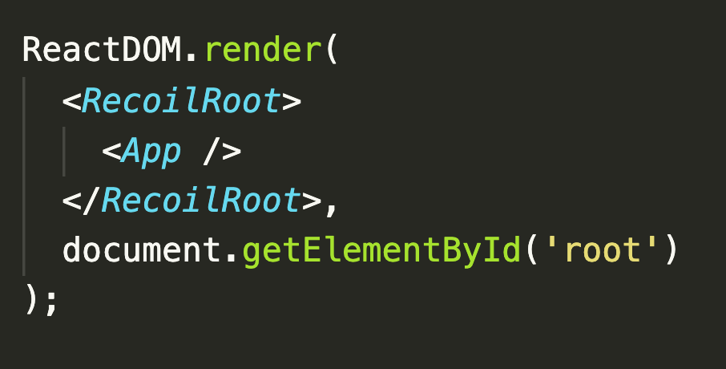
Recoil
Recoil is a state management library for React.
Recoil works with functions, not classes.
Recoil defines a directed graph orthogonal to but also essential and attached to your React tree.
State changes flow from the roots of this graph (which we call atoms) through pure functions (which we call selectors) and into components.
Components that use Recoil state need <RecoilRoot> to appear somewhere in the parent tree.
Notes:
When a React Component is Pure? A function is said to be pure if the return value is determined by its input values only and the return value is always the same for the same input values. A React component is said to be pure if it renders the same output for the same state and props.

Slide 43
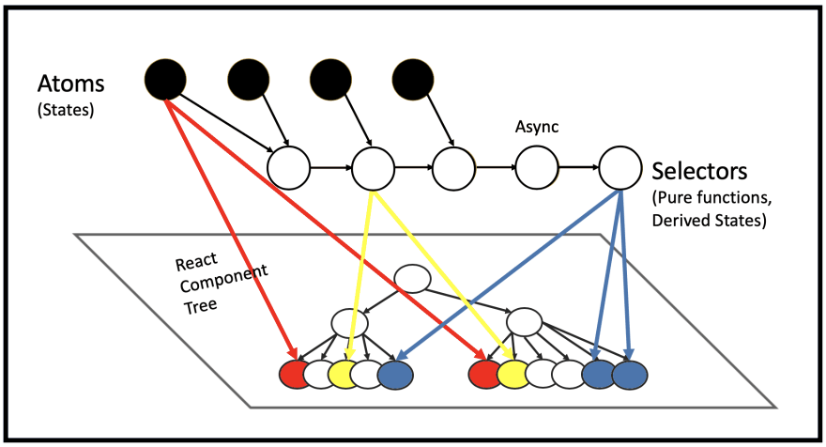
https://dev.to/coleredfearn/atomos-a-new-recoil-visualization-tool-powered-by-react-flow-4b6l
Notes:
Atoms, which are units of the global state provided by Recoil, components can access and subscribe to changes made to them.
Selectors with which we can transform states either synchronously or asynchronously, and components can also access and subscribe to.

Slide 44
textState
Count the number of characters of textState
charCountState
https://dev.to/coleredfearn/atomos-a-new-recoil-visualization-tool-powered-by-react-flow-4b6l
Notes:
Atoms, which are units of the global state provided by Recoil, components can access and subscribe to changes made to them.
Selectors with which we can transform states either synchronously or asynchronously, and components can also access and subscribe to.

Slide 45
ATOM

Slide 46
Atom
Atoms are units /pieces of state. They are updateable and subscribable.
Atoms can be used in place of React local component state.
When an atom is updated, each subscribed component is rendered with the new value.
If an Atom is used from multiple components, all those components share the state.
Atoms can be read from and written to from any component.
Components that read the value of an Atom automatically subscribe to the Atom.
Notes:
minimal state

Slide 47
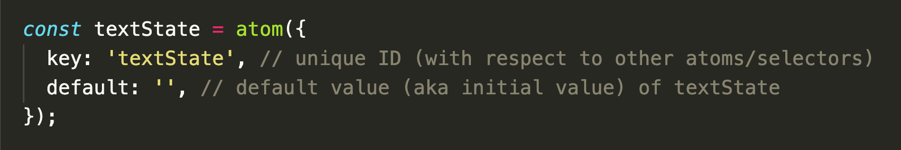
Creating an Atom
Atoms are created with the atom function.
Atoms need a unique key to be called from components
Atoms have a default value

Slide 48
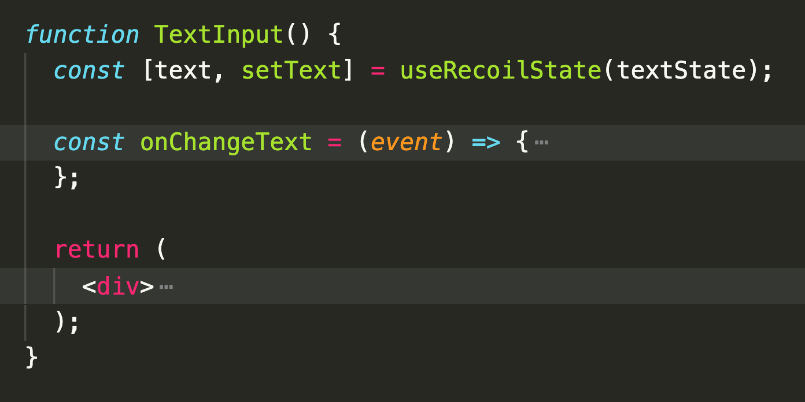
Using an atom from a component
To read or write on an atom from a component, we use a hook called useRecoilState
As useState, useRecoilState returns the state and a function to update it

Slide 49
SELECTOR

Slide 50
Selector
A selector is a pure function that accepts atoms or other selectors as input and calculates derived data that is based on state.
A function is said to be pure if the return value is determined by its input values only and the return value is always the same for the same input values.
A selector transforms a state.
When these upstream atoms or selectors are updated, the selector function will be re-evaluated and the dependent components rerendered.
This lets us avoid redundant state because a minimal set of state is stored in atoms, while everything else is efficiently computed as a function of that minimal state.
Components can subscribe to selectors just like atoms and will then be re-rendered when the selectors change.

Slide 51
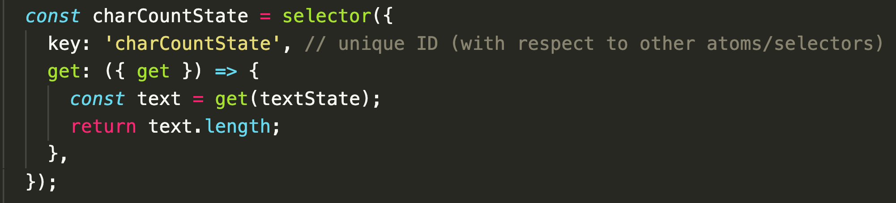
Creating a selector
Selectors need a unique key.
The get property is the function that is to be computed.
The get argument passed to the get function permits to access the values of atoms and other selectors.
When using another atom as a parameter, a dependency relationship is created such that updating the other atom or selector will cause this one to be recomputed.
Notes:
({get}) access to the existing atoms

Slide 52
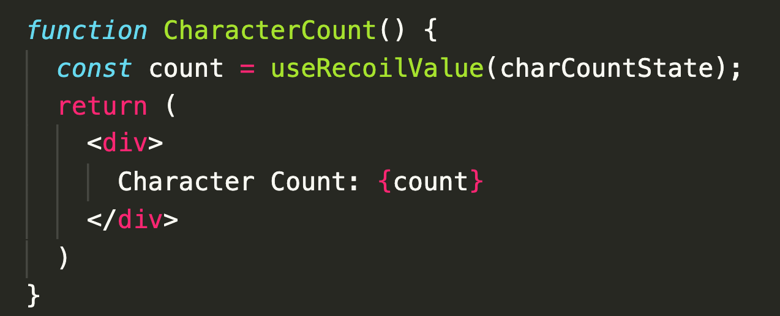
Using a selector
Selectors can be read using the useRecoilValue() hook
which takes an atom or selector as an argument and
returns the corresponding value

Slide 53
useRecoilState(state) | state can be an atom or a writable selector Returns a tuple where the first element is the value of state and the second element is a setter function that will update the value of the given state. Subscribes the component to the given state.
useRecoilValue(state) | state can be an atom or selector Returns the value of the given state. Subscribes the component to the given state.
More on the Recoil API here: https://recoiljs.org/docs/api-reference/core/RecoilRoot

Slide 54
What are the limitations of Recoil?

Slide 55
SETTING UP

Slide 56
Setting up
Be sure to be in the correct directory!
npm install
npm install recoil

Slide 57
DEMO1
https://github.com/tnt-summer-academy/Samples/tree/main/Stretch/recoil-todo-javascript

Slide 59
DEMO2
https://github.com/tnt-summer-academy/Samples/tree/main/Stretch/recoil-todo-javascript

Slide 61
App
TodoList
TodoListStats
TodoListFilters
TodoItemCreator
3 TodoItems

Slide 62
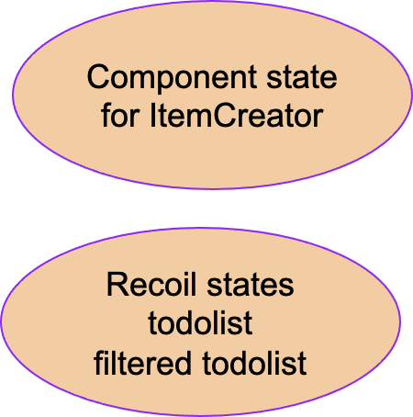
Selector
todoListStatsState
Atom
todoListFilterState
Selector
filteredTodoListState
Atom
todoListState

Slide 63
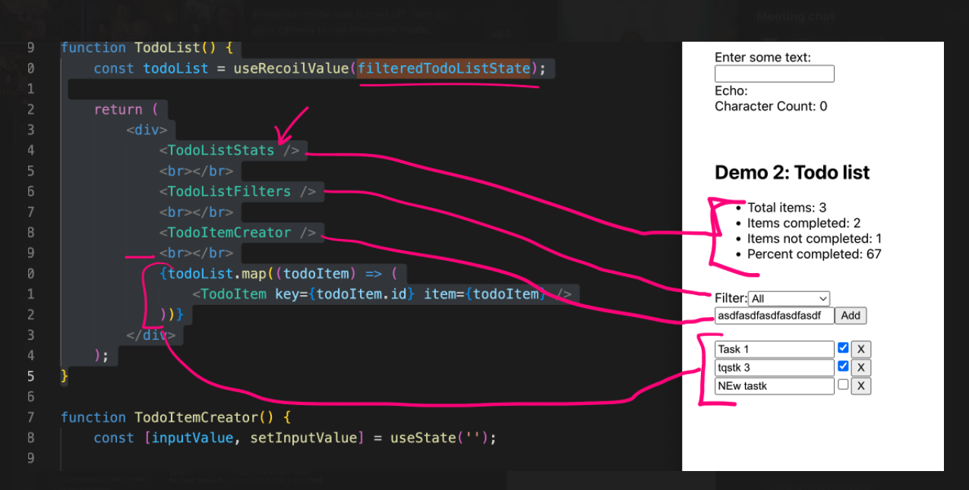

Slide 64
PART 3
OTHER SOLUTIONS

Slide 65
React Context
React Context provides a way to pass data through the component tree without having to pass props down manually at every level." This is ideal for 'global' state, such as theme (dark mode vs. light mode)

Slide 66
Redux
In a way, Redux is like Context, but with a lot more features.
Redux also tries to let you put all your state into one place (called the "Store")
AND it also lets you define all the possible changes that you might want to make (by defining "Actions", objects that mean something like "increment counter" or "decrement counter")
AND it lets you define how to actually make the change happen (via "Reducers", which are methods that actually make the change)
AND you need to provide some 'glue code' that actually connects the Redux-specific stuff to your state.

Slide 67
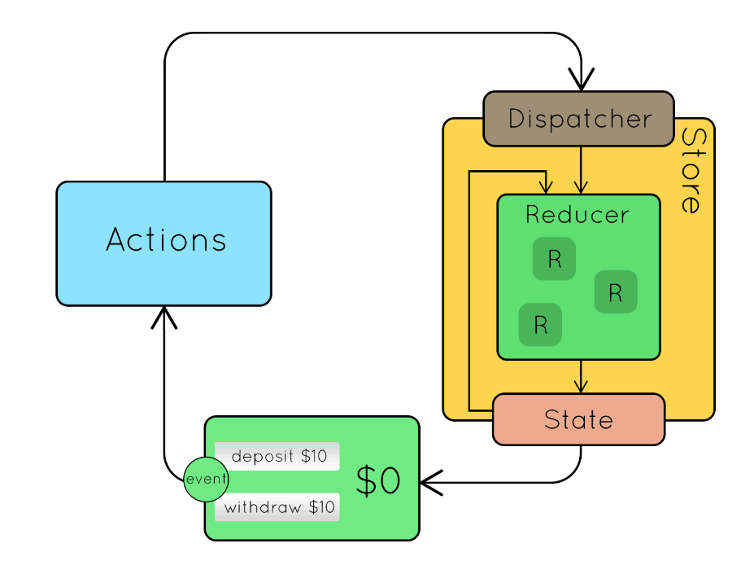
https://github.com/tnt-summer-academy/Curriculum-2022/raw/de4d806e2a19d21d7b5e0941da64d6ab6f2b569a/Stretch%20topics/archive/Redux/moreredux/%5BENG2.5%5DReduxSample.gif

Slide 68
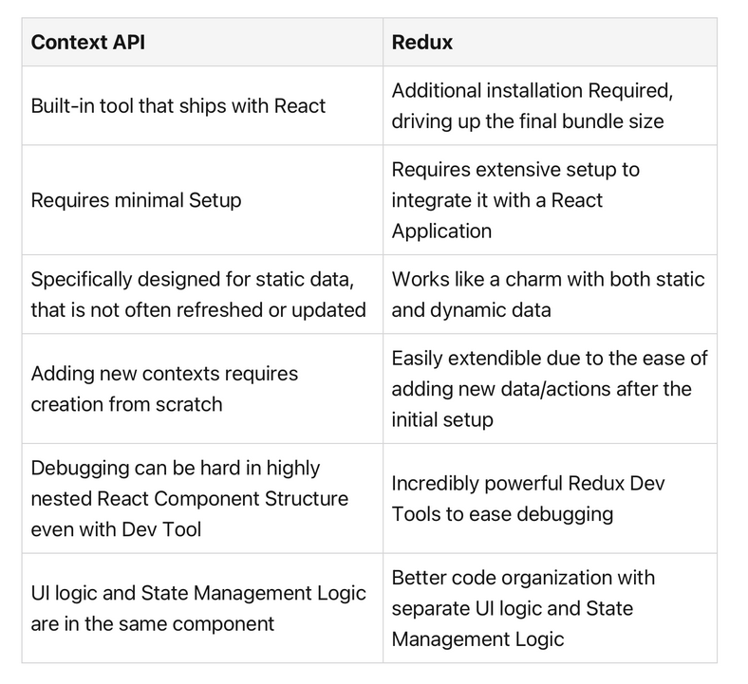

Slide 69
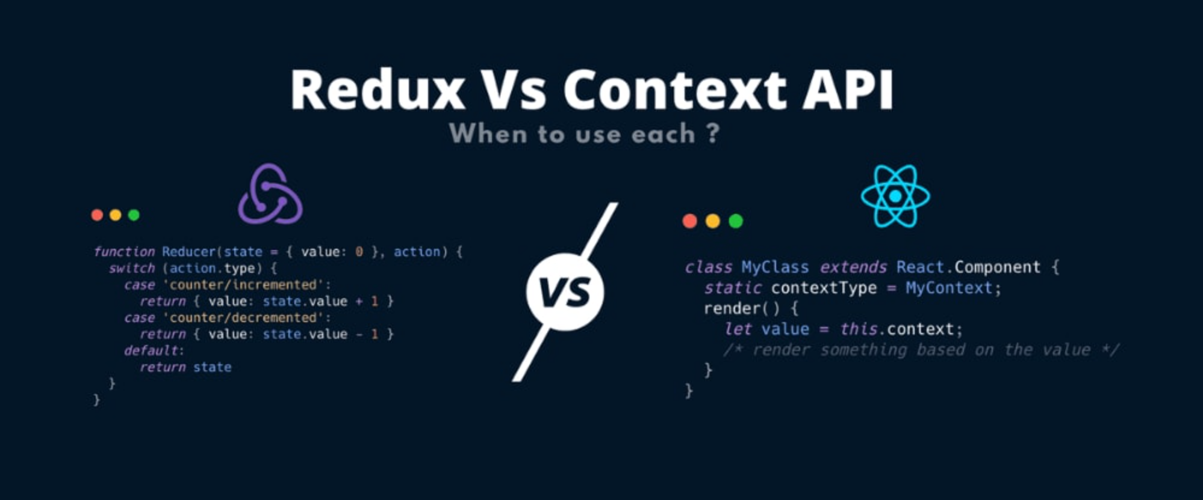

Slide 70
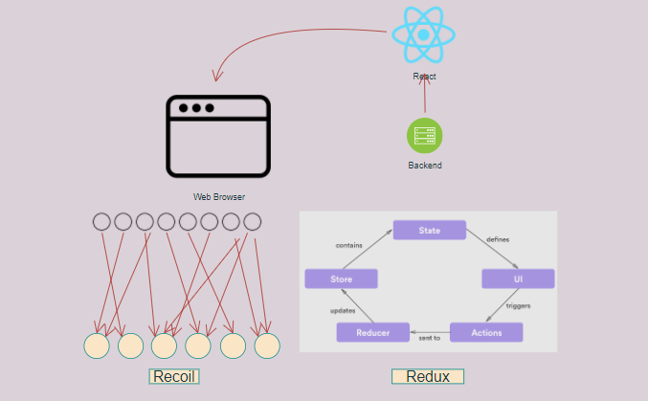

Slide 71
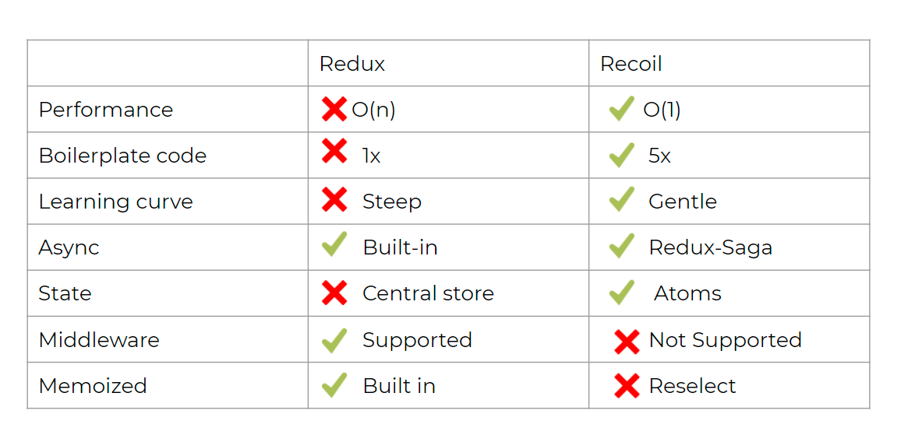

Slide 72
WORK IN YOUR TEAM
ASK QUESTIONS
Good luck with your projects!

